Slide 1

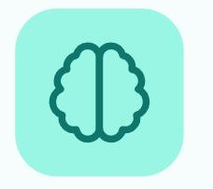
LUMA
Building an Inclusive World for Neurodiverse Individuals
Team Codevengers
Harish Pudake
Chaitanya Sawant
Pradnesh Gawade
Vedant Sonawane
Parth Shinde

Slide 2



THe SIlent CRisis
MIllions Of BRilliant MInds ARe LOcked OUt Of THe WOrkforce BEcause THe WOrld ISn't BUilt For THem.
1-5
85%
3-7%
PEople ARe NEurodivergent
AUtism UNemployment RAte
GLobal GDP LOss

Slide 3




WHy CUrrent SOlutions FAil
TOo EXpensive
TOo GEneric
HArd To REad
PRivate THerapy COsts ₹10k - ₹50k/mo. RUral FAmilies Are LEft BEhind.
STandard APps ARe CLuttered ANd OVerwhelming FOr ADHD/AUtistic BRains.
WAlls Of tExt ANd POor COntrast MAke TOols UNusable FOr DYslexic USers.

Slide 4


INtroducing LUMA
An Inclusive APplication THat ADapts THe USer's BRain, NOt THe OTher WAy ARound.
LUMA VIew
Luma exhibits UI ANd ADjusts COntrast EAsily REadable FOr DYslexic REaders.
Luma LIfe
GAmified ROleplay To PRactice SOcial Cues ANd JOb INterviews SAfely.
Luma HEar
TUrn TExt INto CLarity YOu CAn LIsten To.

Slide 5
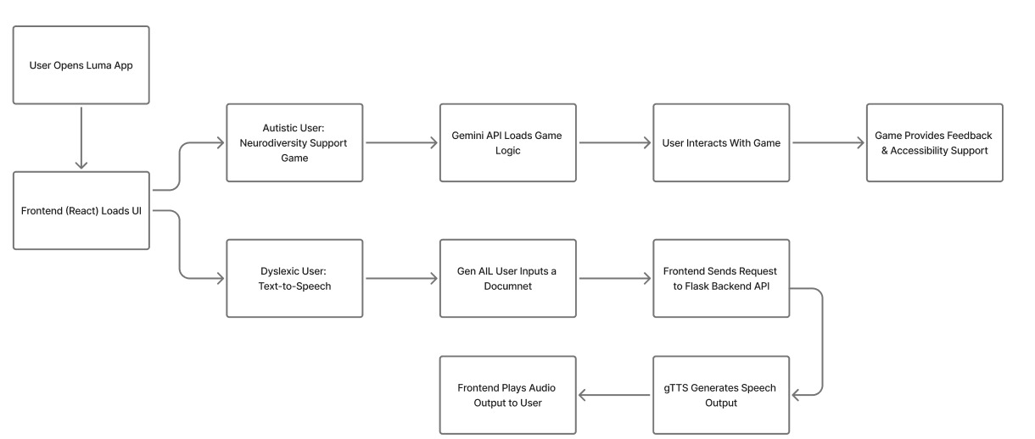
THe LUMA WOrkflow

Slide 6


EXpected IMpact
Patentable Neuro-Assistance Algorithms
Scalable Multi-Platform Accessibility Suite
AI-Driven Personalized Support Engine
Full Multimodal Support
Government and NGO Partnerships

Slide 7
THank YOu.

